Slide 1
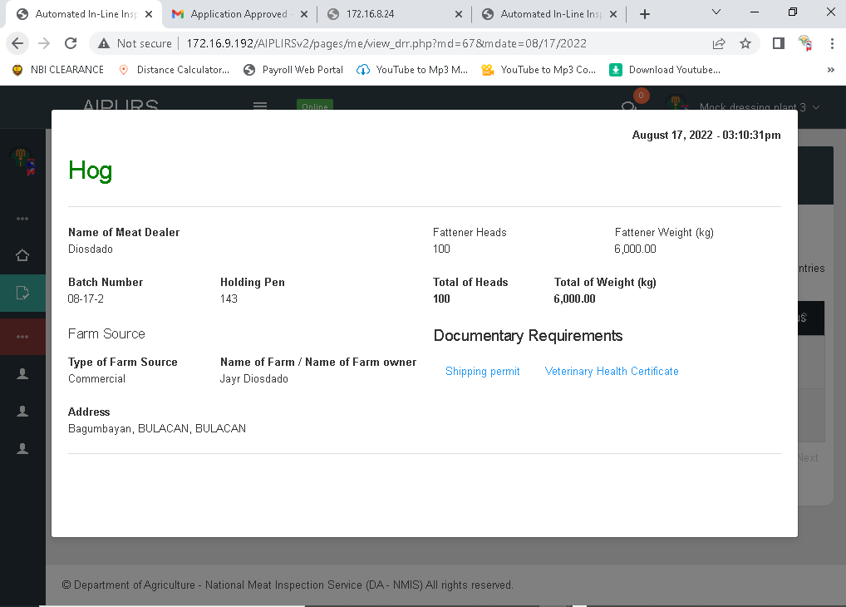
Lastname missing on fullname
Change the label to Total head count
Change the label to Total Live Weight (kg)
Maximize the spacing

Slide 2
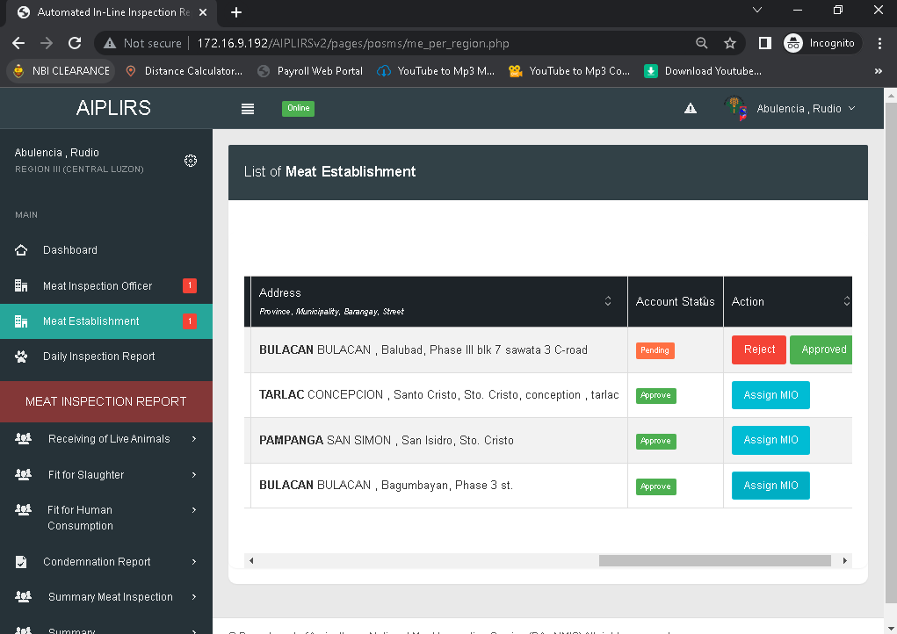
Add a column for the “No. of MIO assigned” and the number is clickable for the pop up of MIO Full details

Slide 3
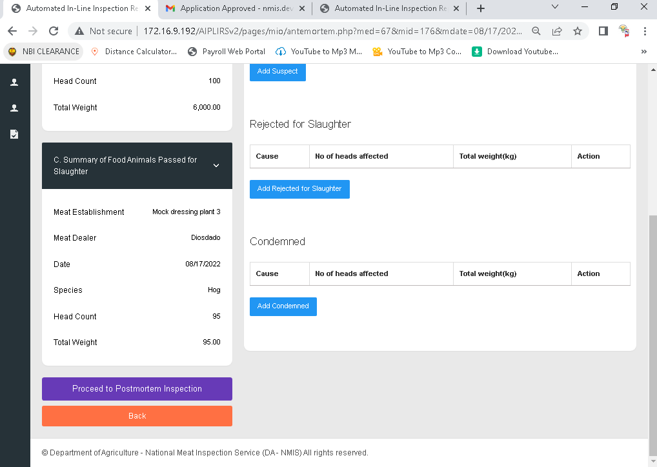
Total weight reflected on total number of head

Slide 4
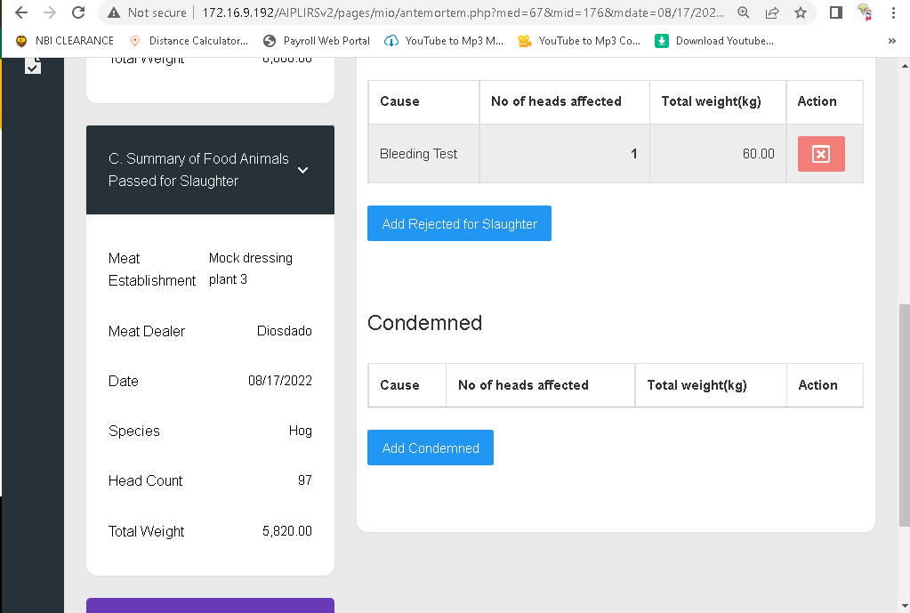
After further inspection on suspect on hold. Passed for slaughter no added

Slide 5
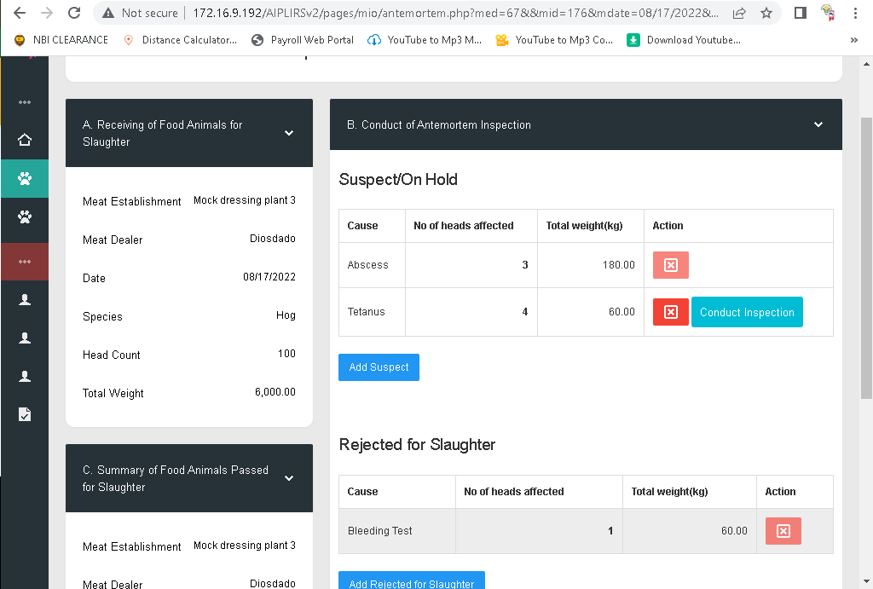
Add a column for the status of Suspected on hold
(Rejected,number of pass for slaughter)

Slide 6
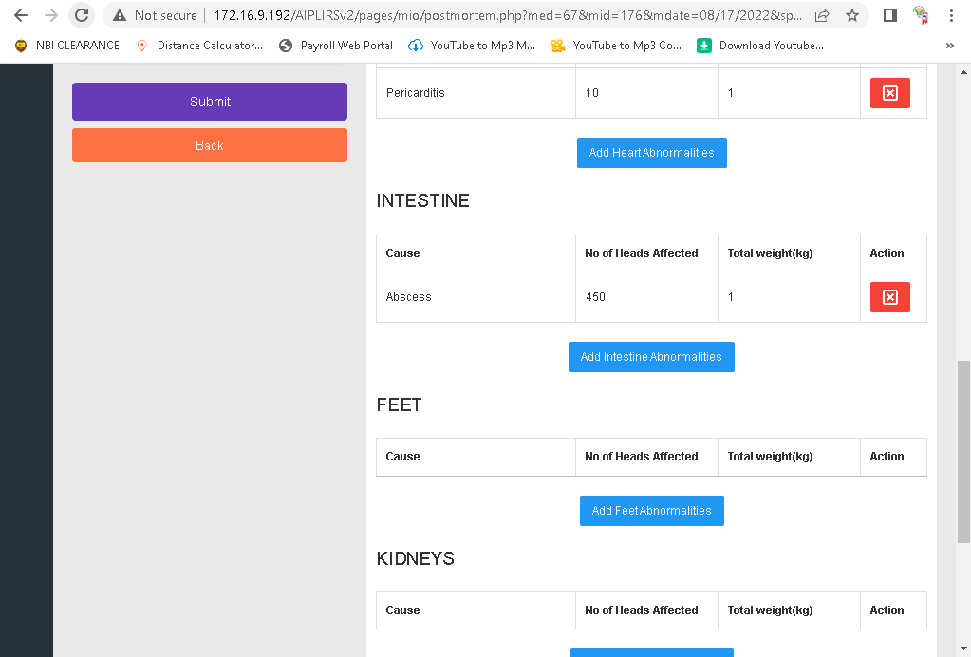
DATA not match based on input field

Slide 7
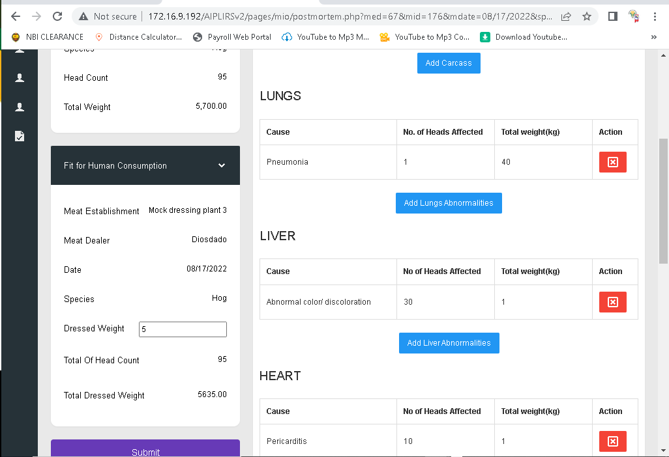
Change label to total live weight
Move total head count after species
Change label to Total dressed weight : corresponding total weight of head count passed for slaughter
Change the label to “total dressed weight fit for human consumption” and the formula will deducted based on what MIO encoded

Slide 8
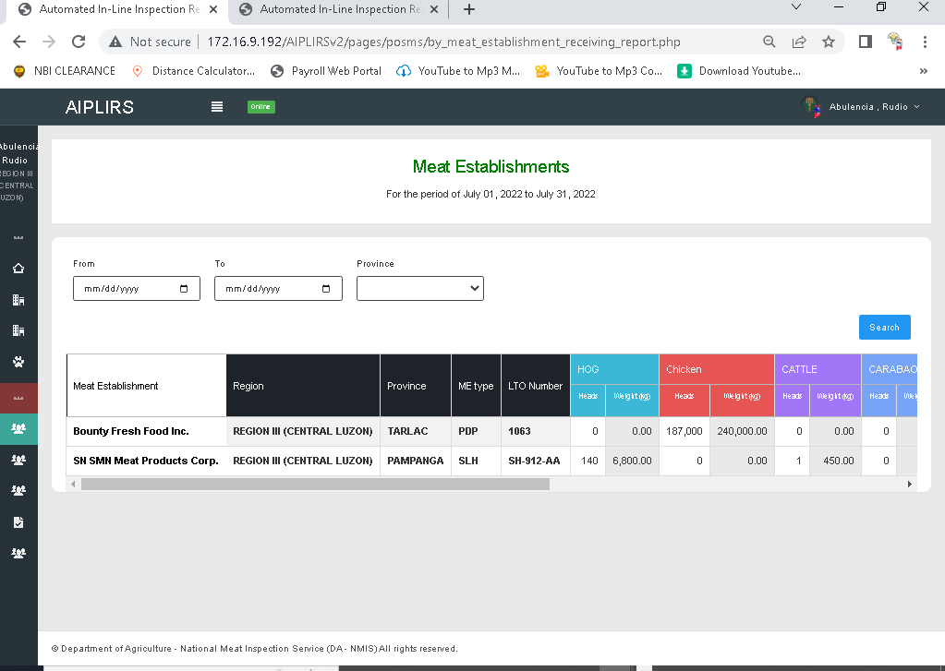
Leave selected date after cliking submit button

